Slide 1
MPCA LAB MINI PROJECT
Smart Car/ Intelligent Vehicular Fixture
SECTION: F2
STUDENTS NAME: Rahul D Makhija, Ramya N Prabhu
SRN’s: PES1UG19CS368 PES1UG19CS380

Slide 2
PROBLEM STATEMENT
With this project, we aim to develop a system/fixture for automobiles that helps a driver reduce his/her efforts, avoid accidents, recognize the signs of an engine that requires maintenance before it is too late and reduce pollution.

Slide 3
INTRODUCTION
Currently, any given vehicle on the road needs help with:
Regular emission check to keep an eye on how the engine is utilizing its fuel and to curb pollution
Regular Temperature check to look out for signs of engine overheating
Distance sensors in the back and at the sides to ensure and enhance the safety of the passengers
The following project aims to not only take care of these needs but also enhance the overall utility. The presence of easy to read indicators and mechanisms that reduce the driver’s efforts makes it a necessary addition for any automobile on the road.

Slide 4
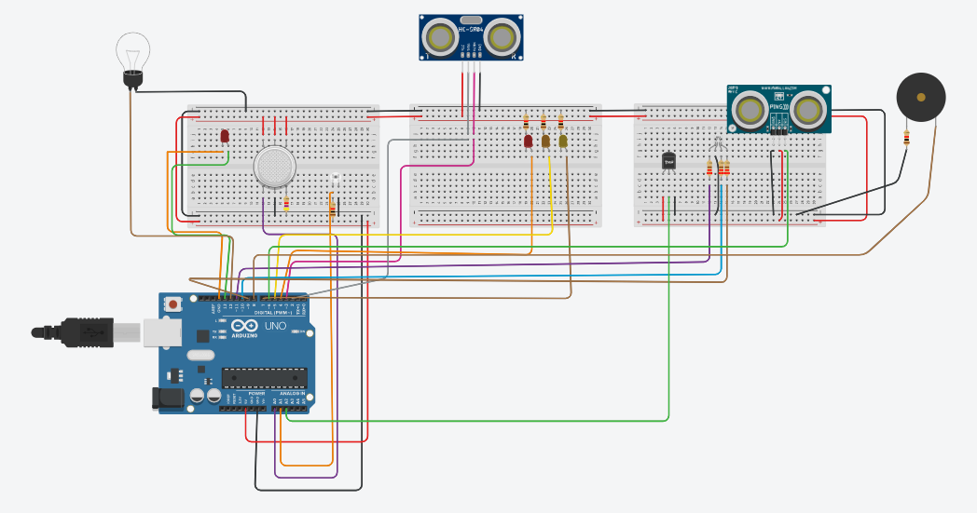
BLOCK DIAGRAM

Slide 5
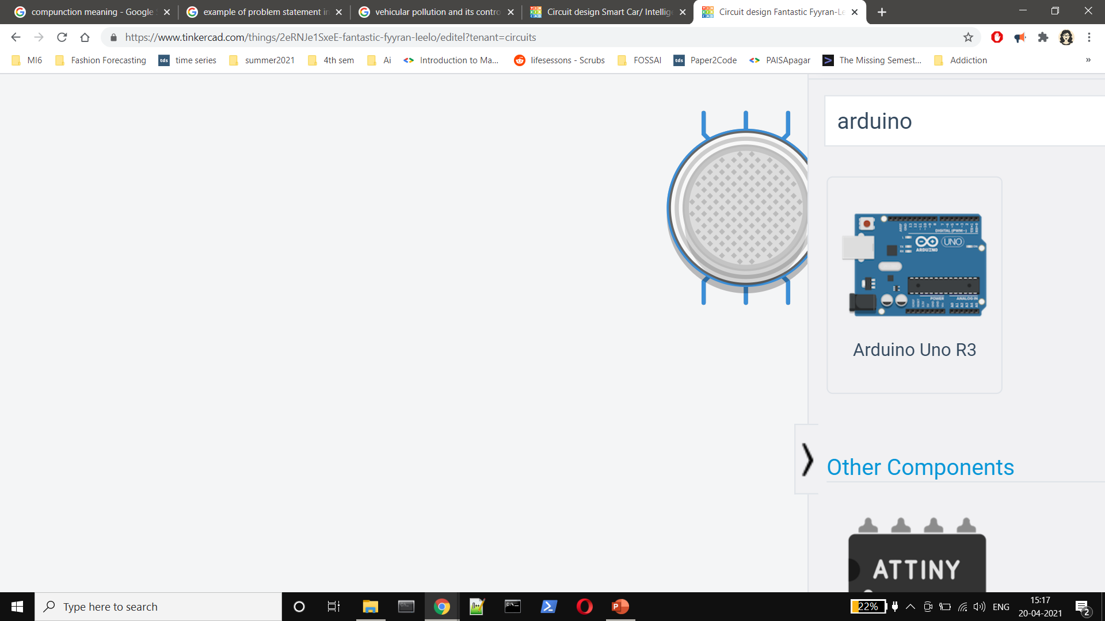

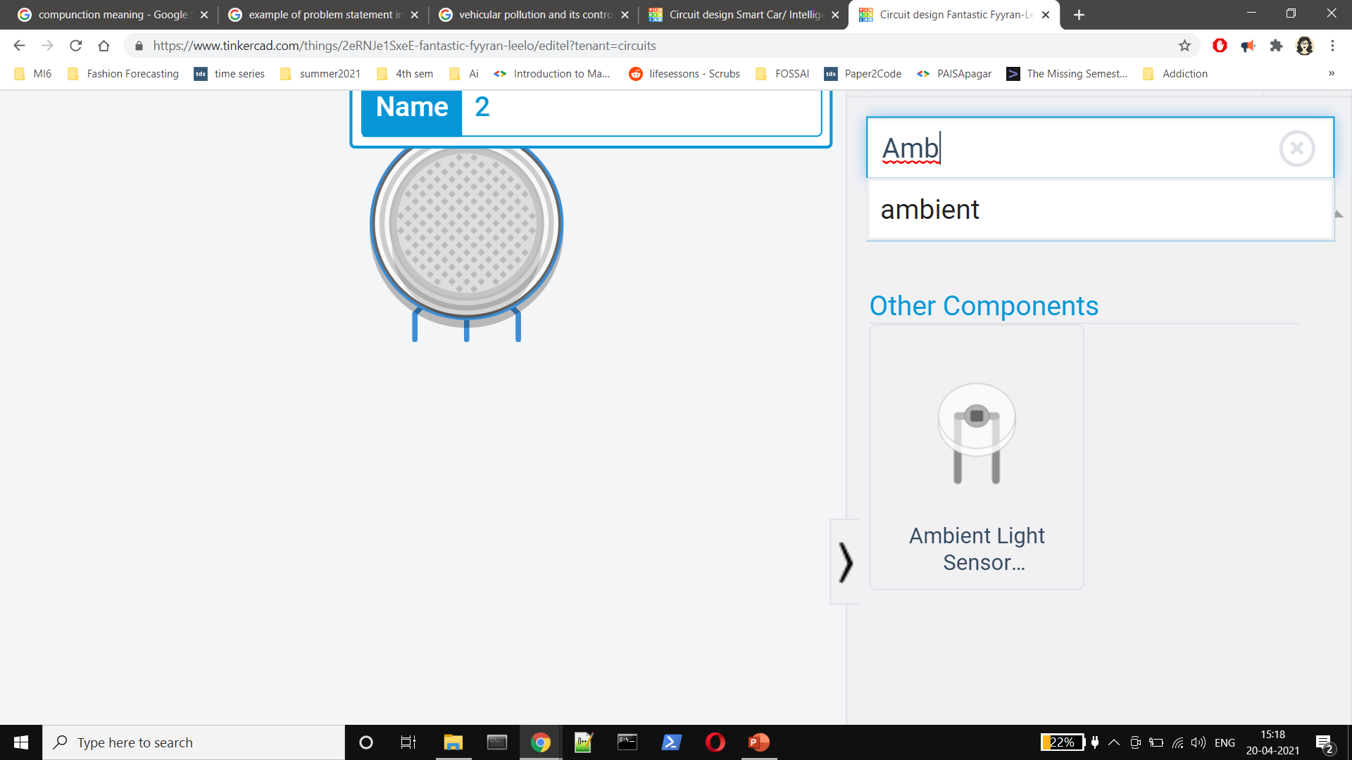
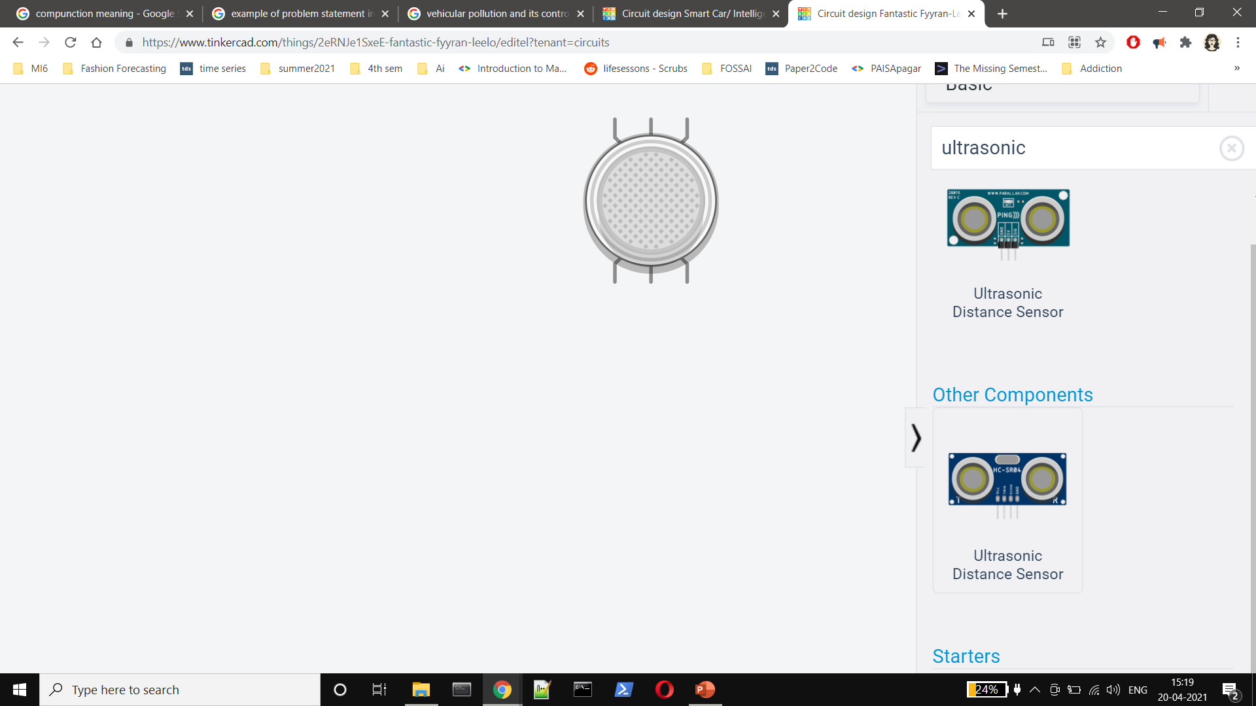
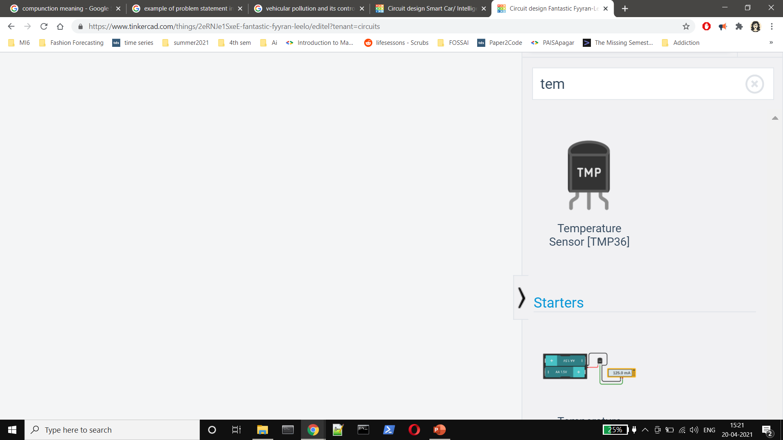
REQUIRED COMPONENTS
X1
X1
X1
X1
X1
X1

Slide 6
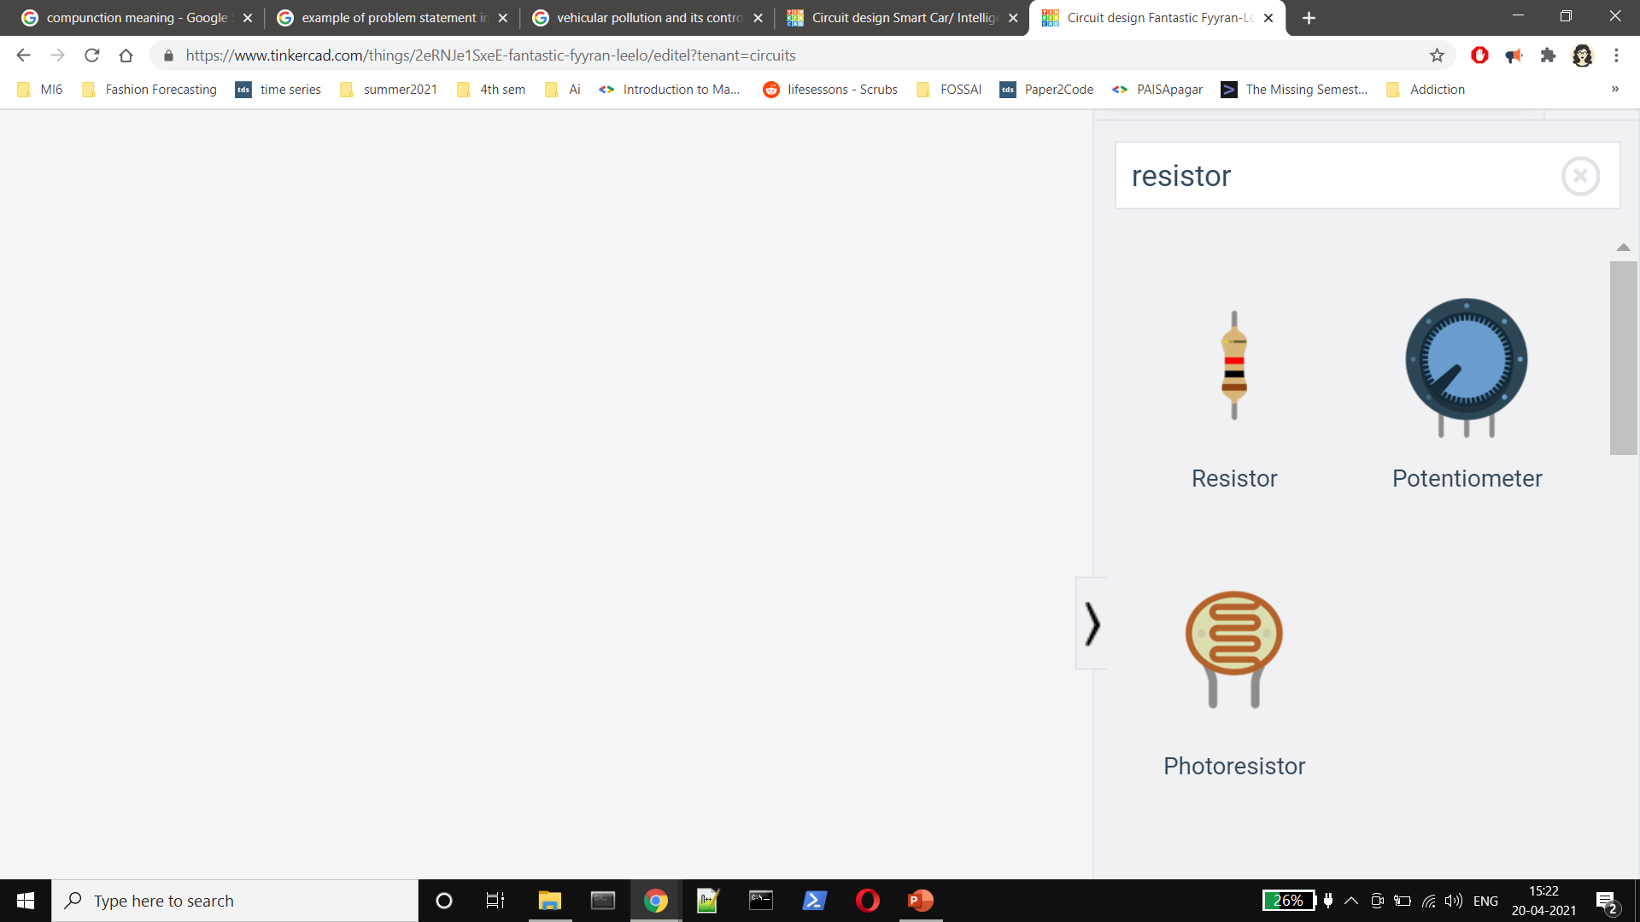

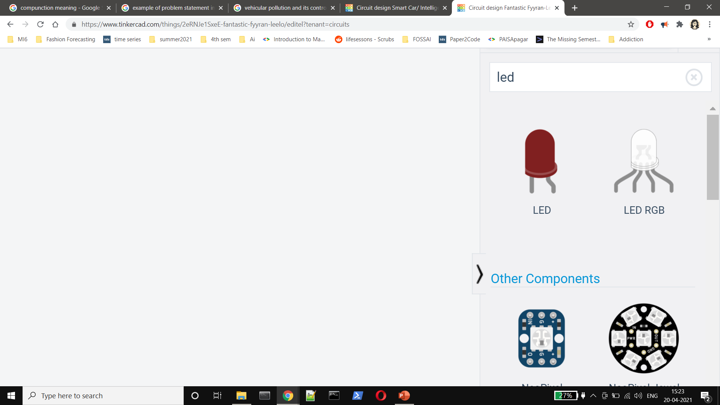
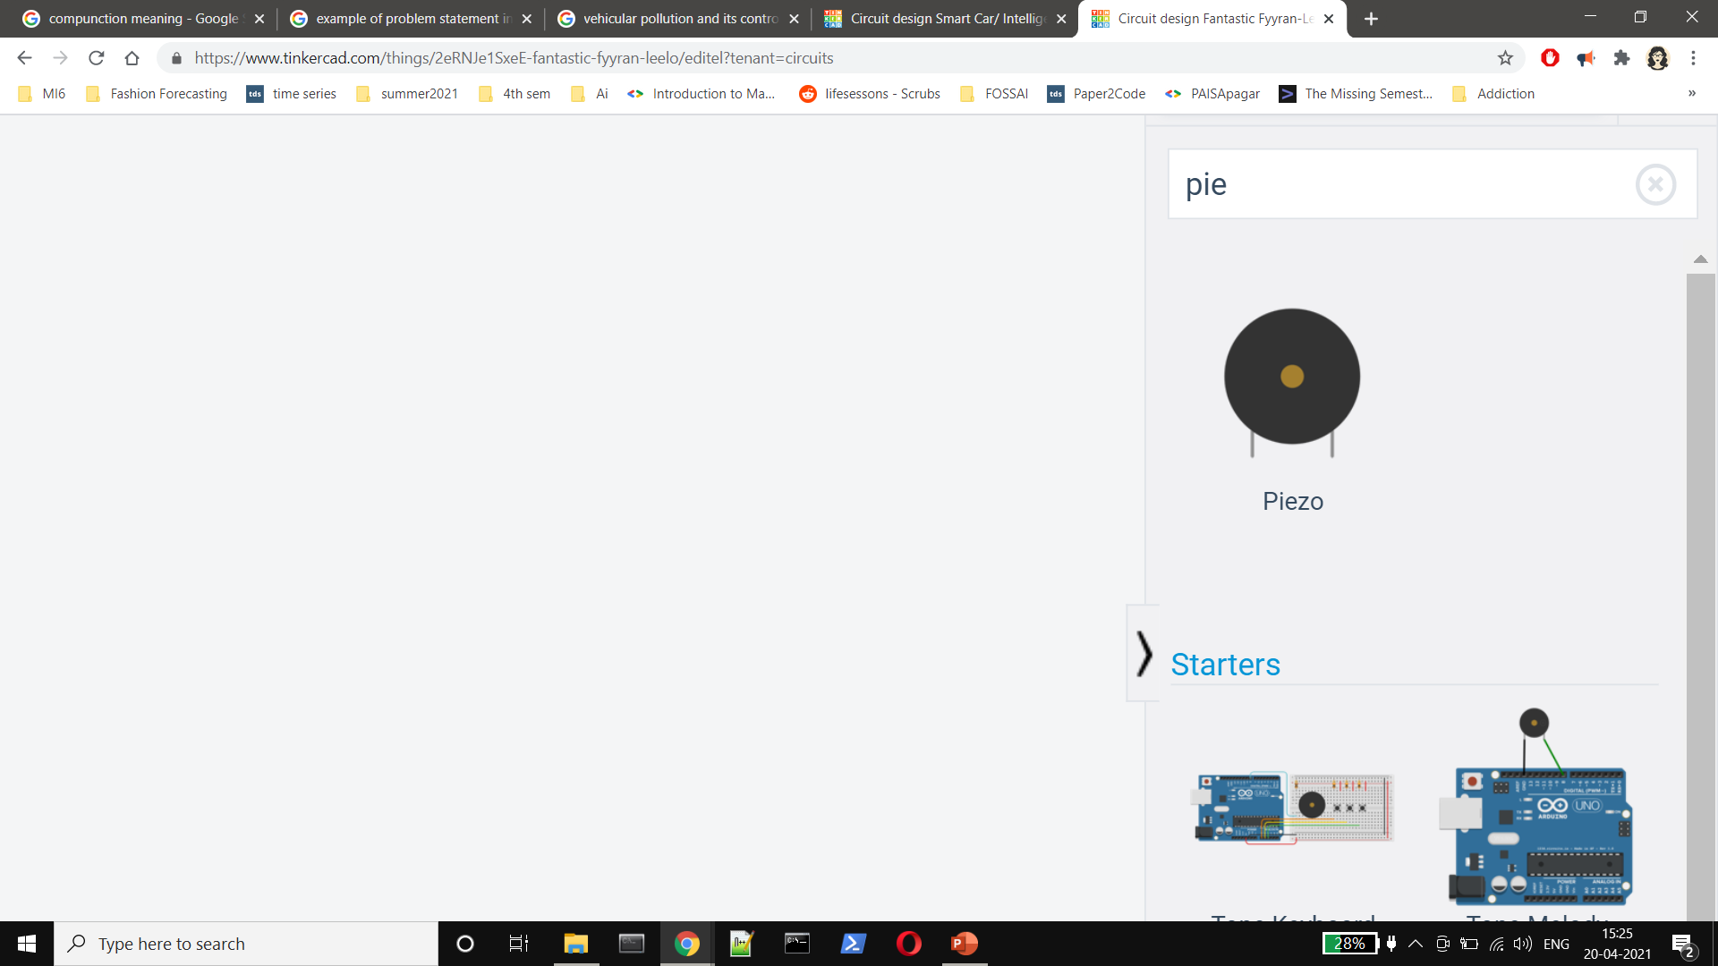

REQUIRED COMPONENTS
x1 4.7 kΩ Resistor
X5 1 kΩ Resistor
X3 220Ω Resistor
x2 Red LED
x1 Yellow LED
x1 Orange LED
X1
X1
And wires. Lots and lots of wires.
X1
x3

Slide 7
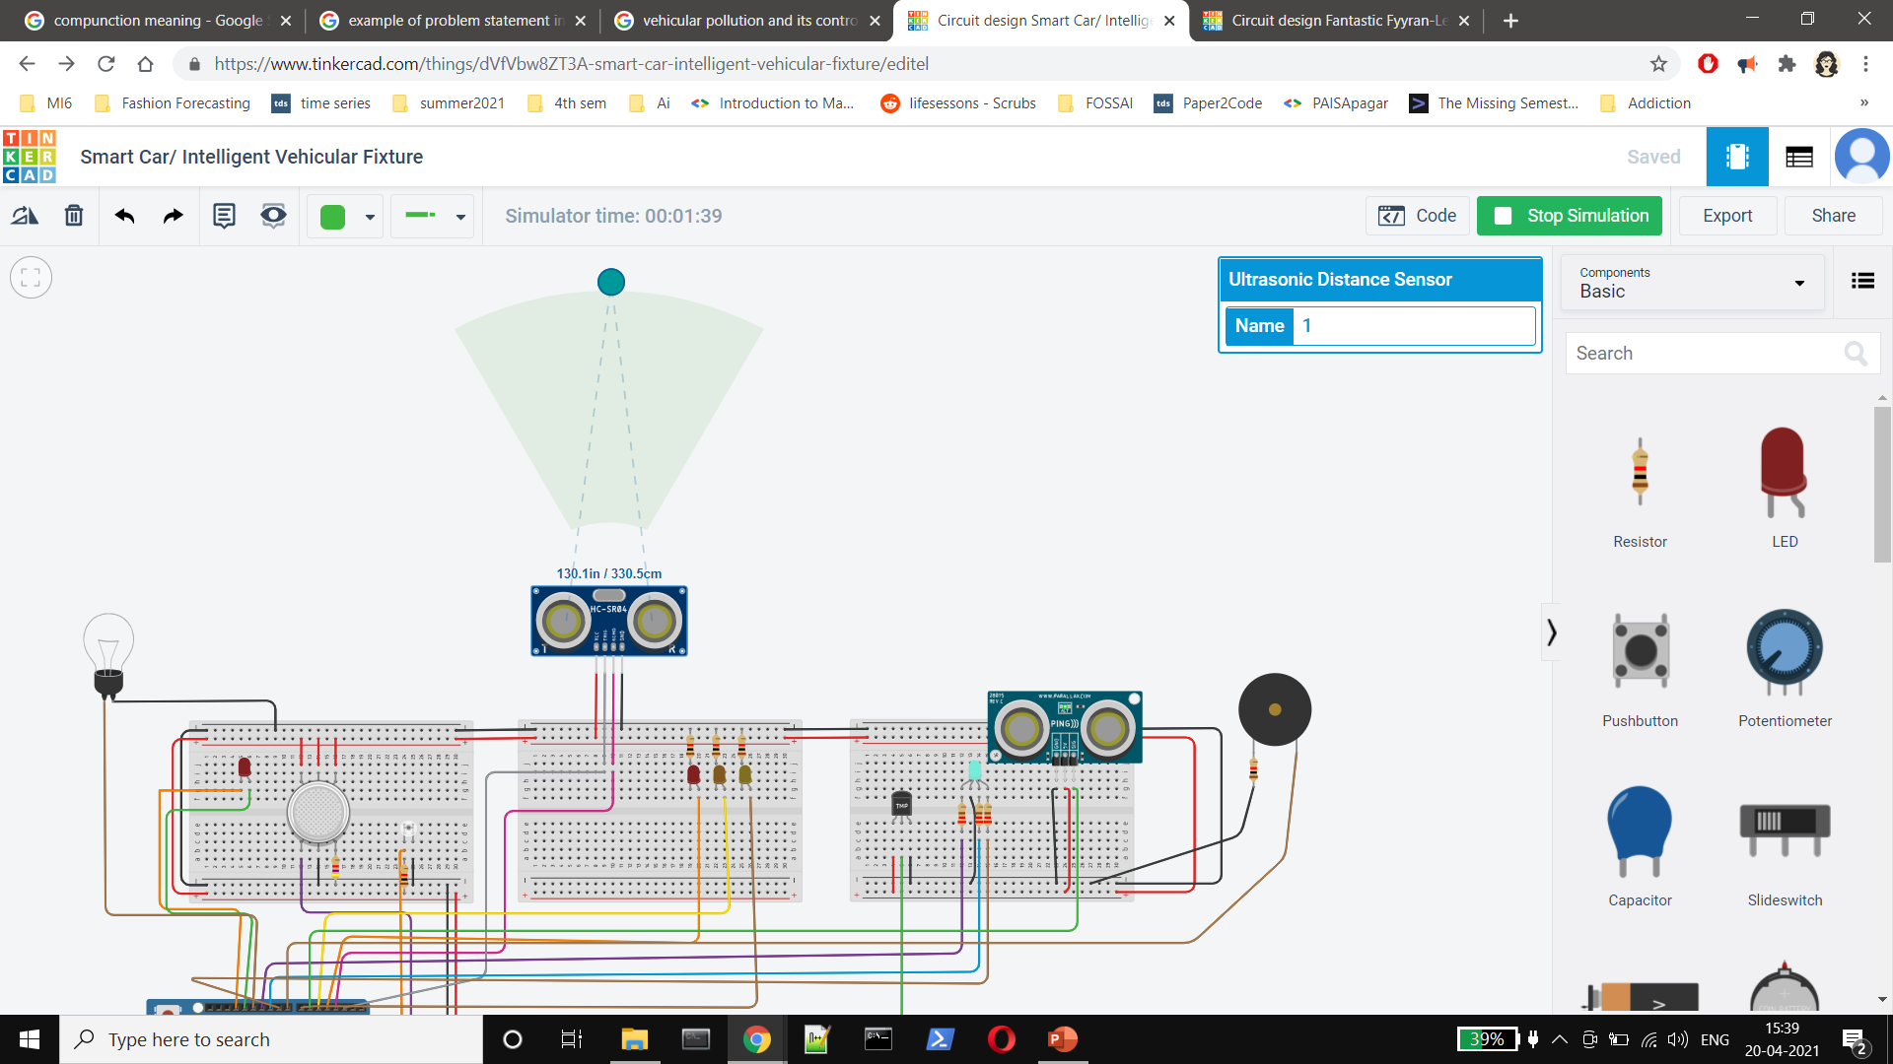



PROJECT DESCRIPTION/DEMONSTRATION
The following Ultrasonic distance sensor goes at the back of the vehicle. It helps with parking and with gauging the distance between the nearest vehicle behind you and your automobile.

Slide 8
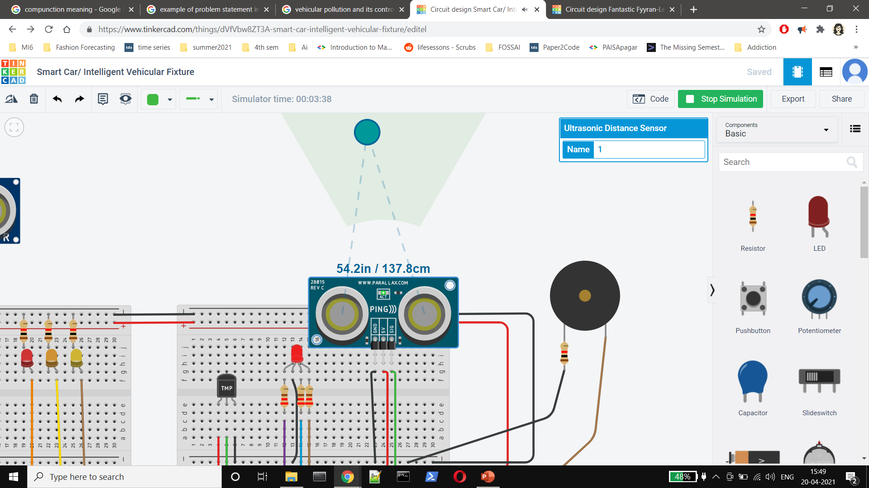
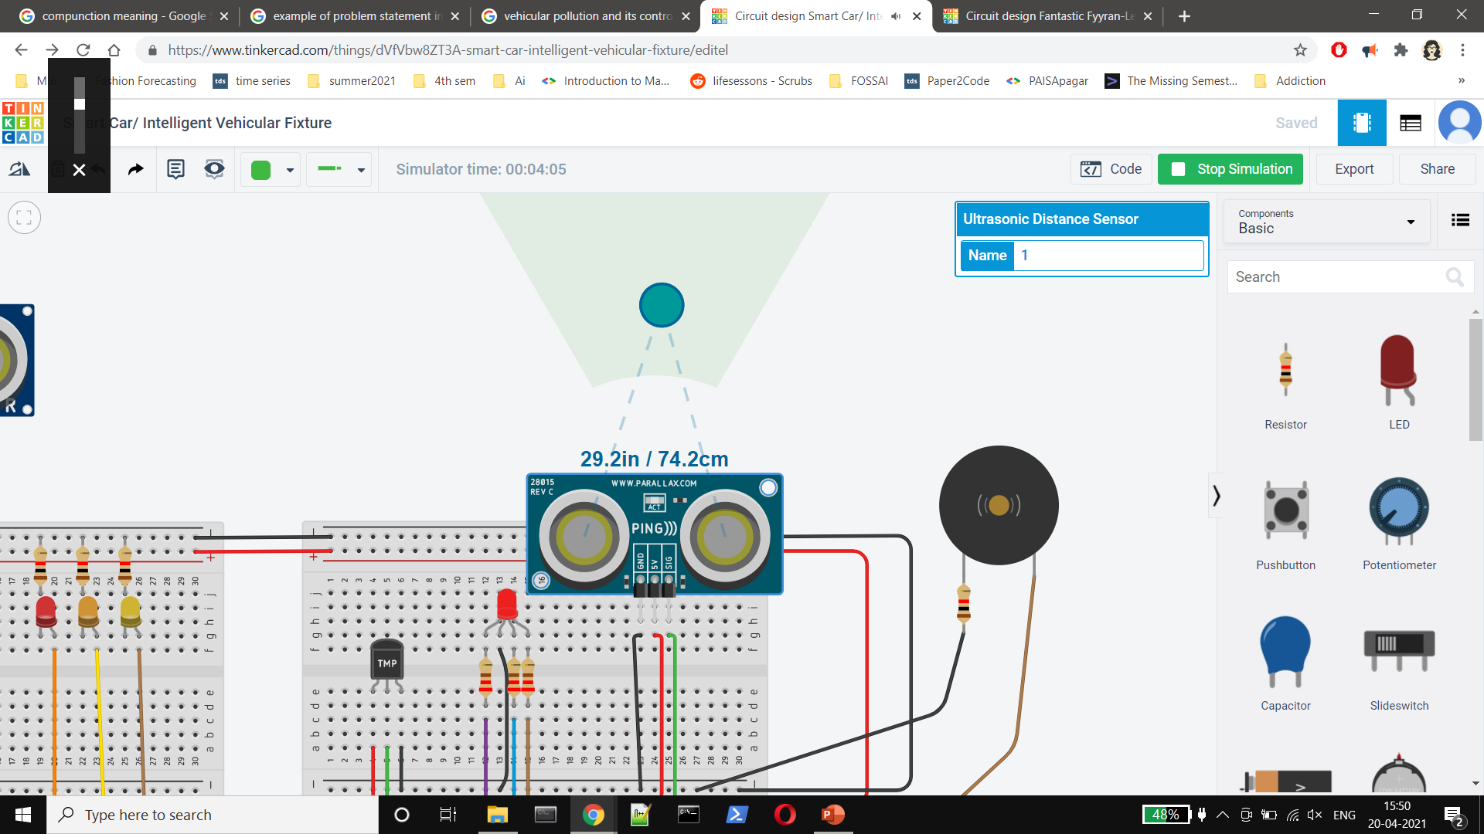
PROJECT DESCRIPTION/DEMONSTRATION
This 3 pin distance sensor goes to the side of your vehicle. In the case that it detects an obstacle closer than a certain threshold, the buzzer goes off.
It helps with parking [to protect the sides of your vehicle] and terrible drivers that try to overtake you on the rode without signaling properly.

Slide 9
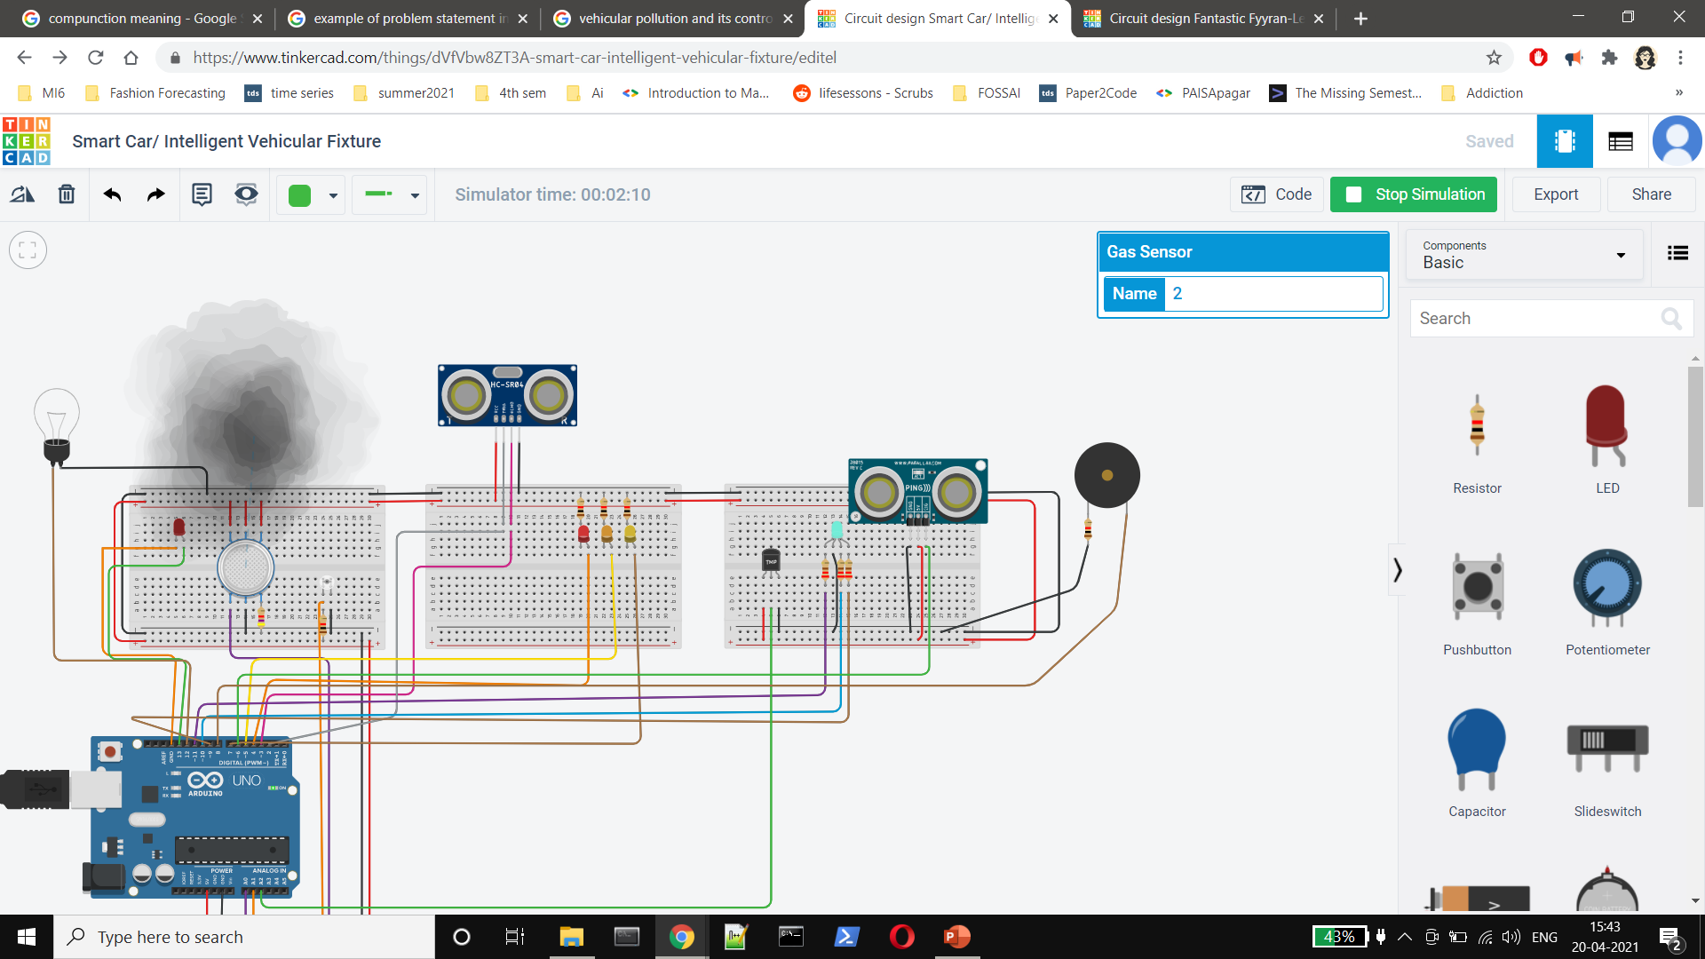
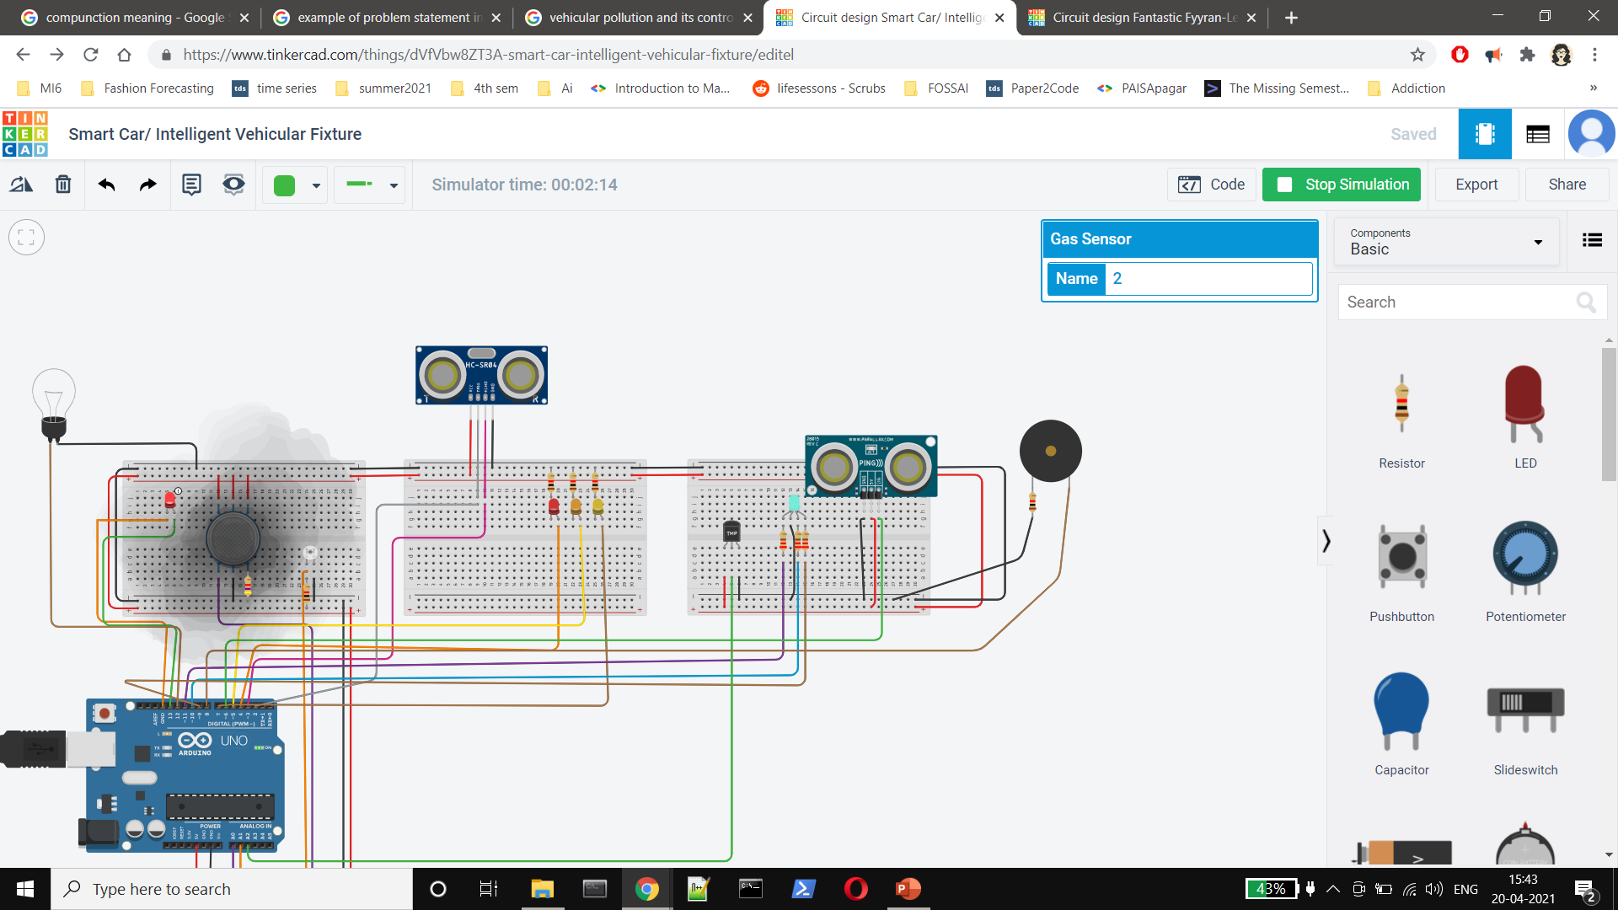
PROJECT DESCRIPTION/DEMONSTRATION
The gas sensor detects the presence of CO and methane, which are, traditionally, signs of an engine that isn’t burning its fuel properly.
In the case that it detects that the concentration of any/all of these gases are above a certain threshold, the led associated with it begins to glow.

Slide 10
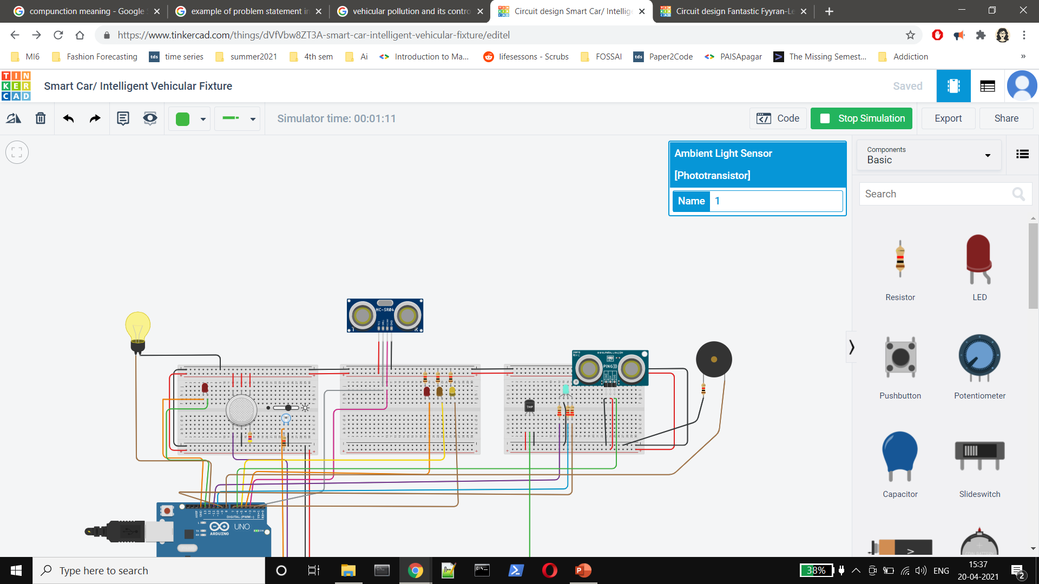

PROJECT DESCRIPTION/DEMONSTRATION
The ambient light sensor, on sensing drop in the amount of ambient daylight below a certain threshold, turns on the bulb, aka head lights.

Slide 11
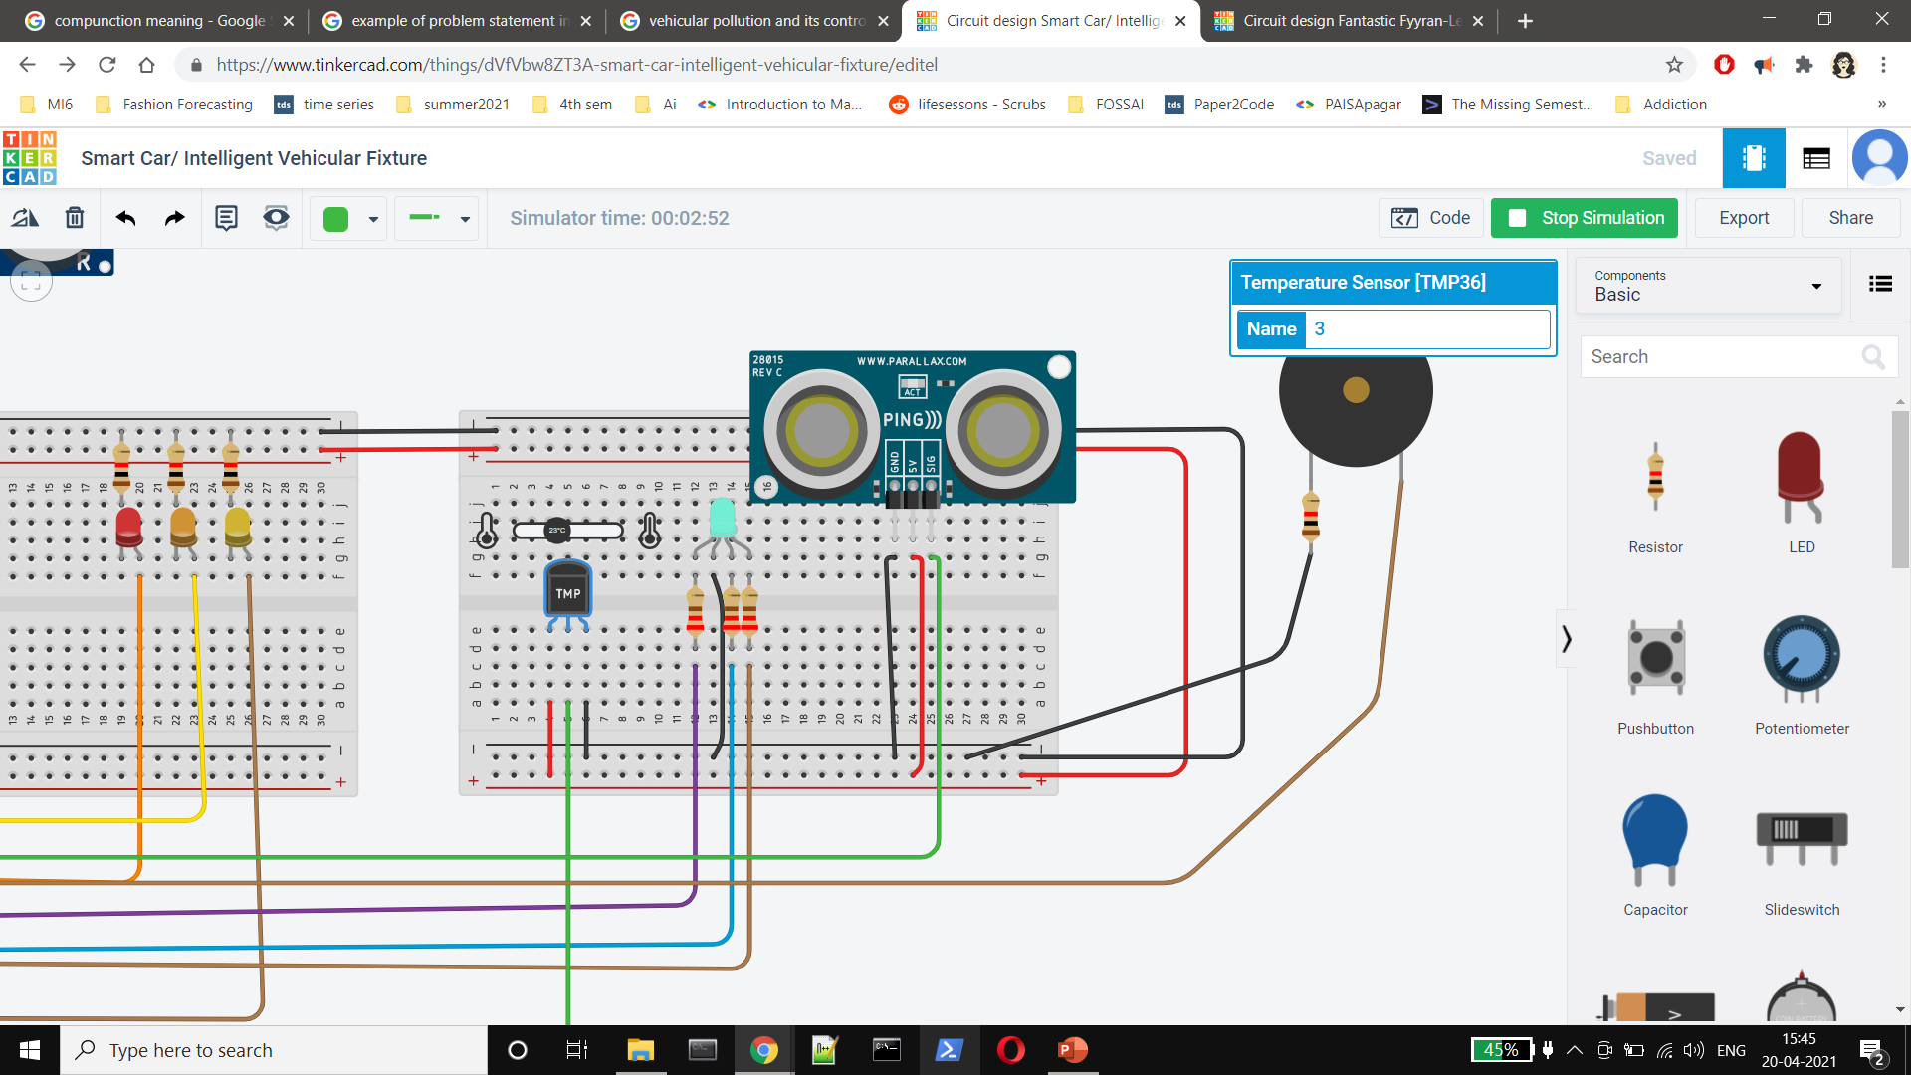
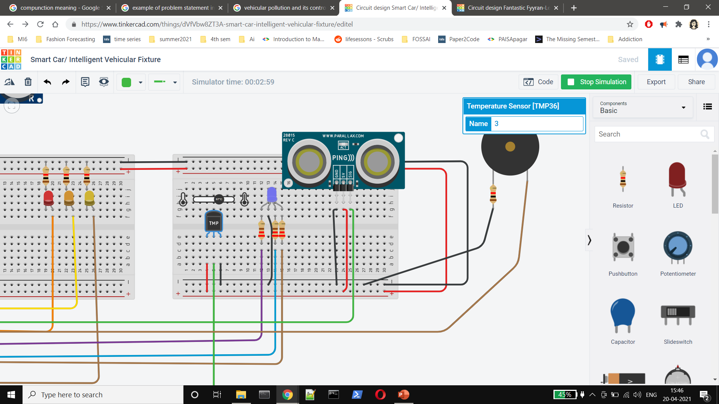

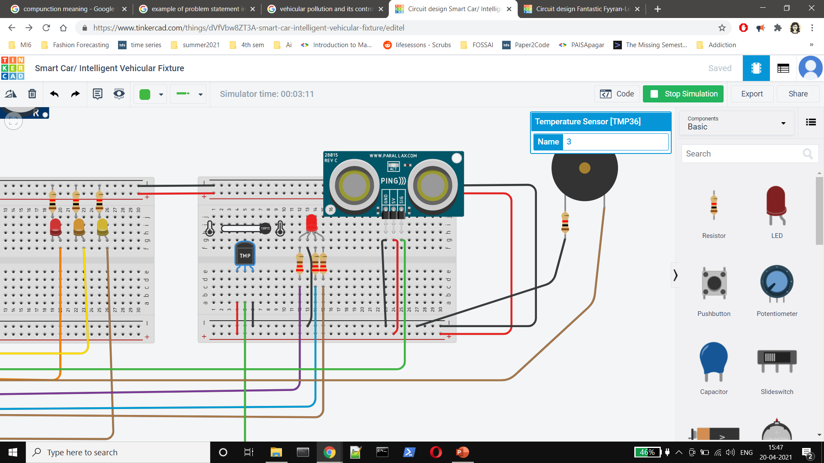
PROJECT DESCRIPTION/DEMONSTRATION
The temperature sensor keeps a check on the engine’s temperature. The color of the led indicator varies from blue to red depending on the temperature and where it falls on the scale.

Slide 12
APPLICATIONS
This system can be used in any land vehicle to not only enhance its safety but also to help the owner of the vehicle recognize the need for maintenance at an early stage
In case of vehicles like buses and trucks, the ultrasonic distance sensor helps prevents the driver from getting into an accident with the vehicles behind.
It helps with parking safely, noticing automobiles that try to overtake your vehicle dangerously, and helps switch on your headlights in case you forget them.

Slide 13
REFERENCES(Website links, Books etc.)
https://www.instructables.com/Ultrasonic-Distance-Sensor-Arduino-Tinkercad/
https://www.instructables.com/TMP36-Temperature-Sensor-Arduino-Tinkercad/
https://www.tinkercad.com/things/62rR2MBj7FM-led-control-with-ambient-light-sensor
https://www.instructables.com/RGB-LED-Color-Mixing-With-Arduino-in-Tinkercad/
https://www.instructables.com/Arduino-Gas-Detecting-Alarm-System/

Slide 14
THANK YOU

